Slide 1
CHAPTER 11:
Sampling Distributions
The Basic Practice of Statistics
6th Edition
Moore / Notz / Fligner
Lecture PowerPoint Slides
Notes:
Basic Practice of Statistics - 3rd Edition
Chapter 5

Slide 2

Chapter 11 Concepts
Parameters and Statistics
Statistical Estimation and the Law of Large Numbers
Sampling Distributions
The Sampling Distribution of
The Central Limit Theorem

Slide 3
Chapter 11 Objectives
Define and identify parameters and statistics
Describe the law of large numbers
Define and describe sampling distributions
Describe the sampling distribution of sample means
Describe and apply the central limit theorem

Slide 4

Parameters and Statistics
As we begin to use sample data to draw conclusions about a wider population, we must be clear about whether a number describes a sample or a population.
A parameter is a number that describes some characteristic of the population. In statistical practice, the value of a parameter is not known because we cannot examine the entire population.
A statistic is a number that describes some characteristic of a sample. The value of a statistic can be computed directly from the sample data. We often use a statistic to estimate an unknown parameter.
Remember s and p: statistics come from samples and
parameters come from populations
We write µ (the Greek letter mu) for the population mean and σ for the population standard deviation. We write (x-bar) for the sample mean and s for the sample standard deviation.

Slide 5
Statistical Estimation
The process of statistical inference involves using information from a sample to draw conclusions about a wider population.
Different random samples yield different statistics. We need to be able to describe the sampling distribution of possible statistic values in order to perform statistical inference.
We can think of a statistic as a random variable because it takes numerical values that describe the outcomes of the random sampling process. Therefore, we can examine its probability distribution using what we learned in earlier chapters.
Population
Sample
Collect data from a representative Sample...
Make an Inference about the Population.

Slide 6









Sampling Variability
This basic fact is called sampling variability: the value of a statistic varies in repeated random sampling.
To make sense of sampling variability, we ask, “What would happen if we took many samples?”
Population
Sample
Sample
Sample
Sample
Sample
Sample
Sample
Sample

Slide 7
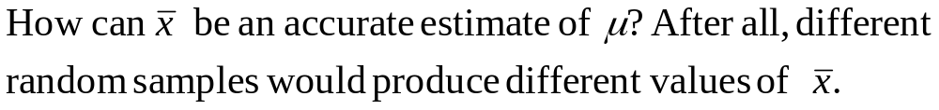
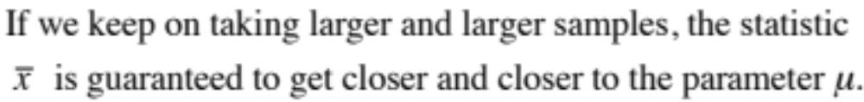
The Law of Large Numbers
Draw observations at random from any population with finite mean µ.
The law of large numbers says that as the number of observations drawn increases, the sample mean of the observed values gets closer and closer to the mean µ of the population.

Slide 8
Sampling Distributions
The law of large numbers assures us that if we measure enough subjects, the statistic x-bar will eventually get very close to the unknown parameter µ.
If we took every one of the possible samples of a certain size, calculated the sample mean for each, and graphed all of those values, we’d have a sampling distribution.
The population distribution of a variable is the distribution of values of the variable among all individuals in the population.
The sampling distribution of a statistic is the distribution of values taken by the statistic in all possible samples of the same size from the same population.
In practice, it’s difficult to take all possible samples of size n to obtain the actual sampling distribution of a statistic. Instead, we can use simulation to imitate the process of taking many, many samples.

Slide 9
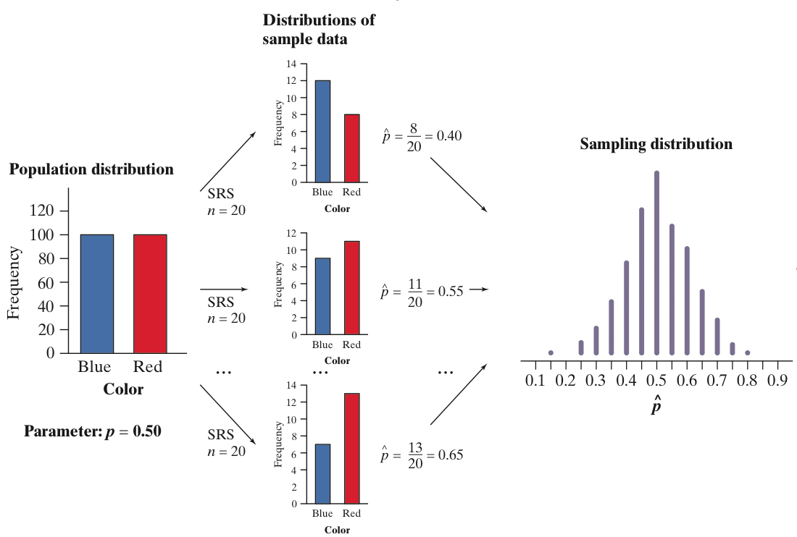
Population Distributions vs.
Sampling Distributions
There are actually three distinct distributions involved when we sample repeatedly and measure a variable of interest.
The population distribution gives the values of the variable for all the individuals in the population.
The distribution of sample data shows the values of the variable for all the individuals in the sample.
The sampling distribution shows the statistic values from all the possible samples of the same size from the population.

Slide 10

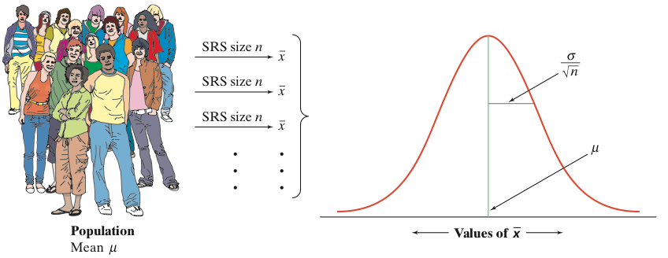
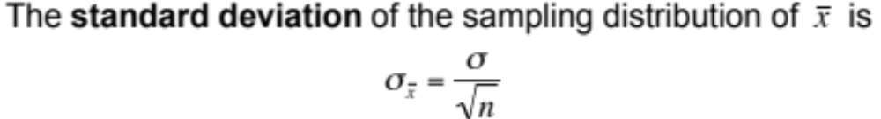
The Sampling Distribution of
When we choose many SRSs from a population, the sampling distribution of the sample mean is centered at the population mean µ and is less spread out than the population distribution. Here are the facts.
The Sampling Distribution of Sample Means
If individual observations have the N(µ,σ) distribution, then the sample mean of an SRS of size n has the N(µ, σ/√n) distribution regardless of the sample size n.

Slide 11
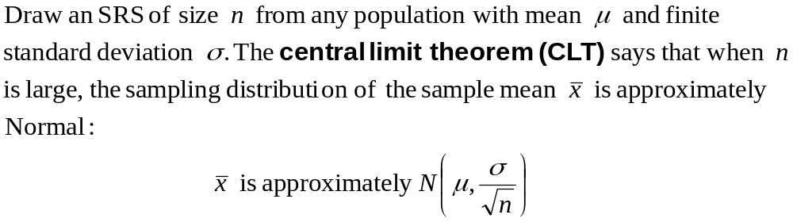
The Central Limit Theorem
Most population distributions are not Normal. What is the shape of the sampling distribution of sample means when the population distribution isn’t Normal?
It is a remarkable fact that as the sample size increases, the distribution of sample means changes its shape: it looks less like that of the population and more like a Normal distribution!
When the sample is large enough, the distribution of sample means is very close to Normal, no matter what shape the population distribution has, as long as the population has a finite standard deviation.

Slide 12
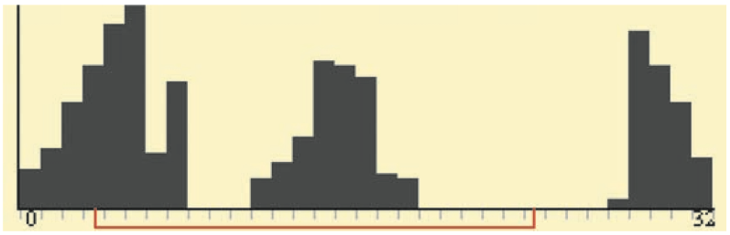
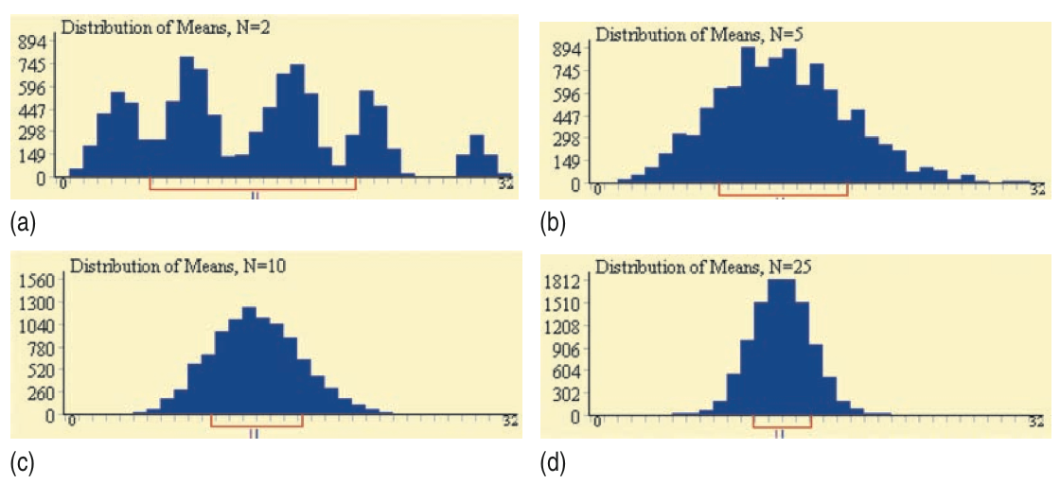
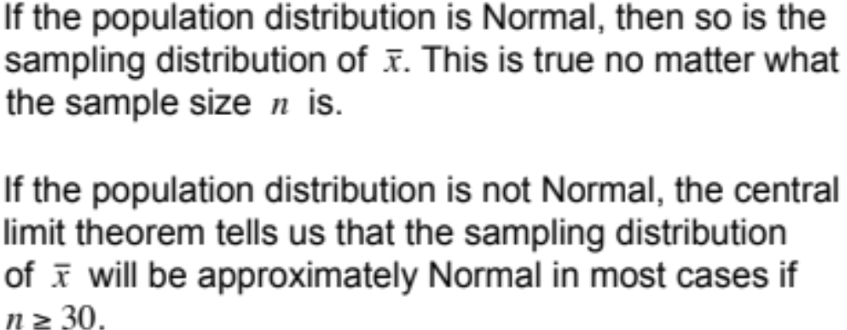
The Central Limit Theorem
Consider the strange population distribution from the Rice University sampling distribution applet.
Describe the shape of the sampling distributions as n increases. What do you notice?
Normal Condition for Sample Means

Slide 13
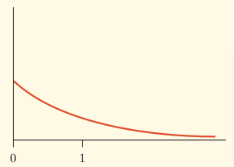
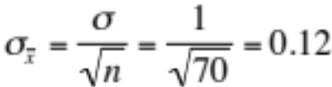

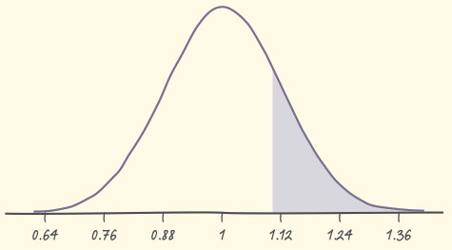


Example
Based on service records from the past year, the time (in hours) that a technician requires to complete preventative maintenance on an air conditioner follows the distribution that is strongly right-skewed, and whose most likely outcomes are close to 0. The mean time is µ = 1 hour and the standard deviation is σ = 1.
Your company will service an SRS of 70 air conditioners. You have budgeted 1.1 hours per unit. Will this be enough?
The central limit theorem states that the sampling distribution of the mean time spent working on the 70 units has:
The sampling distribution of the mean time spent working is approximately N(1, 0.12) since n = 70 ≥ 30.
If you budget 1.1 hours per unit, there is a 20% chance the technicians will not complete the work within the budgeted time.

Slide 14
Chapter 11 Objectives Review
Define and identify parameters and statistics
Describe the law of large numbers
Define and describe sampling distributions
Describe the sampling distribution of sample means
Describe and apply the central limit theorem

